Slide 1





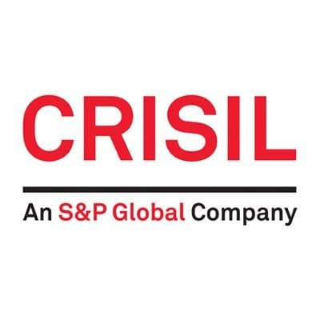
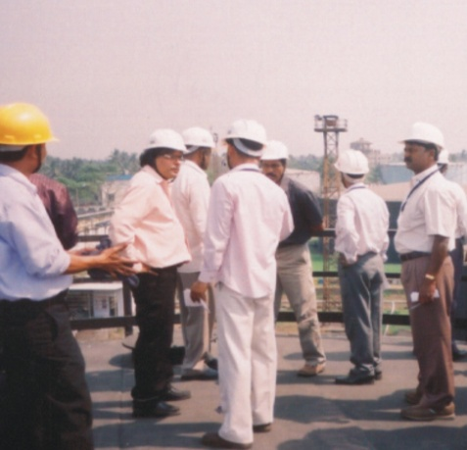

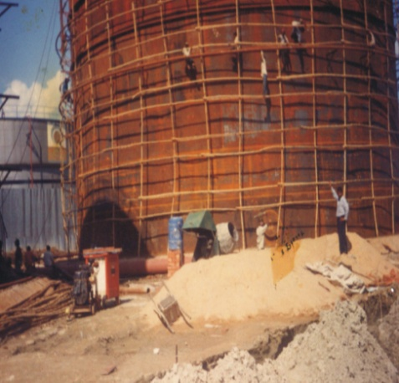
M/S GIRISH CHANDRA GHOSH & G.G.S.
Govt. of West Bengal approved license holder of Legal Metrology Dept., Govt. of West Bengal, Odisha, Jharkhand, Chattishgarh, Sikkim & works under Legal metrology Dept. of other states in India .
HERITAGE OF BENGAL IN BUSINESS ACTIVITIES
www.girishcalibration.com
To continue please click on muse or press spacebar / arrow keys

Slide 2

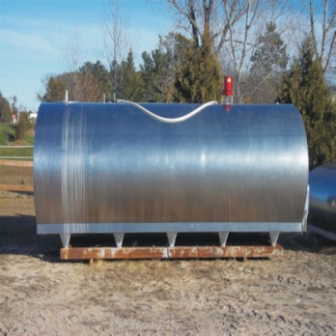
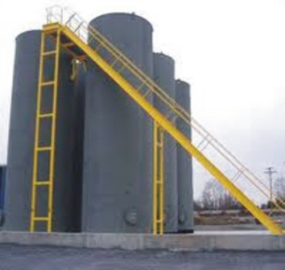
Why calibration is essential
To ascertain gain or loss in sales, purchase to provide only reliable means of maintaining adequate control over the storage & distribution & stock keeping in industrial production process control as oil, chemicals and it’s allied products are very costly items business and service render from it.
Profit and Loss depends on accuracy of storage tank calibration work
Settlement of disputes in management, production purchase / sales cycle
Tank calibration services
Vertical Cylindrical Large diameter storage tanks.
Horizontal Cylindrical tanks and pressurised bullets.
Horton spheres and ship tanks.
All types of process tanks and vat.
Ultrasonic thickness testing of tanks and pipelines.
Tank settlement roundness and tilt survey.

Slide 3

About Us
WHO ARE WE?
We are an independent company head quartered in Kolkata, India undertaking tank calibration, inspection, certification ultrasonic testing, tank settlement and tilt survey. Our company is government approved license for calibration of petroleum, chemicals, oil and liquid storage tanks. Our calibration of tanks helped many companies in achieving and maintaining ISO quality certification with the desired accuracy, traceability and measurement standard required by ISO.
OUR EDGE
We are now consortium of efficient. Responsive and experienced engineers with on – field technical expertise combined with computer – aided mathematical volume analysis. We certainly have the edge with constant technological innovation and upgradation - meeting international standard and solving intricate problems like tilted horizontal tanks and volume of uneven floors.
OUR COMMITMENT
The leading company in calibration world. We are committed to meet consumers requirement by offering consistent quality service and at competitive price. Company’s profit depends on the accuracy of storage tank calibration chart.
OUR FOCUS
To make the tank owner understand the extreme importance of accurate volumes. Tank calibration and survey helps the owner of the tank to get a through feedback about inventory, product quality and tank health, which if wrongly executed may prove costly and disastrous. A through understanding of any tank characteristic has earned us the reputation of a first hand solution provider in the industry – In India.

Slide 4
OUR VISION
Our vision is to become the recognized industry leader by our customers in the Storage Tank Calibration businesses in which we compete.
Safety – Safety serves as a barometer of our company’s overall success and is a specific measure of our operating excellence
Trust – Trust is the mutual respect for and confidence in people. Trust recognizes the importance of individuals and appreciates their diverse opinions. Trust compels us to share information and encourage new ideas. It requires an open, honest, forthright manner.
Teamwork – Teamwork is personal involvement and collaboration in a team environment. It includes setting a common goal in support of business objectives, making an individual commitment to the team’s success and recognizing the success of the team.
Accountability – Being accountable means every employee assumes ownership and responsibility for his or her own work, regardless of the job they perform. Being accountable means making decisions and holding oneself responsible for the consequences of those choices.
Quality – Quality is the primary determinant of customer satisfaction and loyalty, and it requires employees to continuously provide internal and external customers with the right product or service...done right...the first time. In today’s increasingly competitive business environment, better quality translates into better value for our customers and, subsequently, better value for their customers-and this is the very essence of competitive differentiation.
OUR MISSION
We are trying to keep our old goodwill and maintain customer satisfaction and to serve our society and social development at large.
In Storage Tank Calibration Work our Mission / Goal for modernization (subject to weights & measure Dept. approval) we will introduce safe laser beam measurement are also used for internal diameter measurement specifically for Horton sphere and underground cylindrical tanks.
A combination of traditional physical calibration to the latest laser distance ranging and optical triangulation technology may be adopted in near future for accuracy. At the same time we will try to acquire all India license for all states in India in our activity.

Slide 5
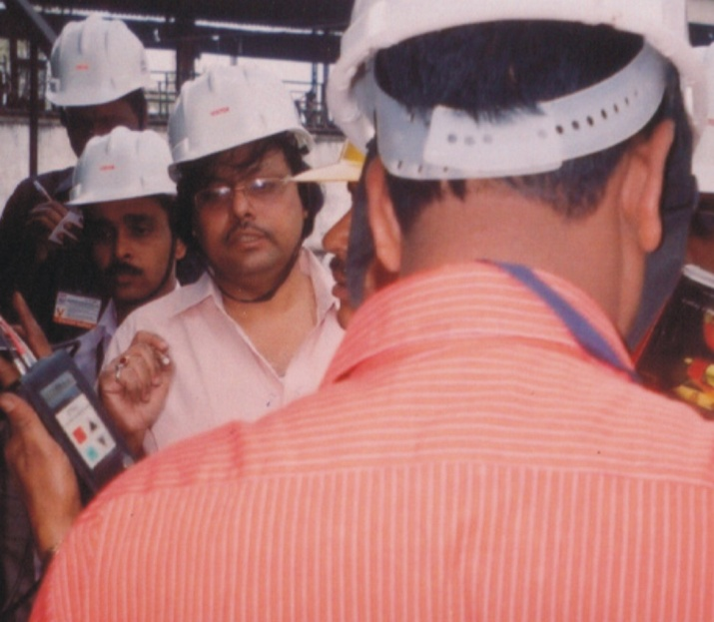
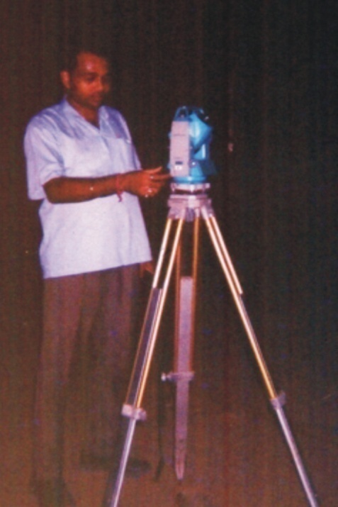
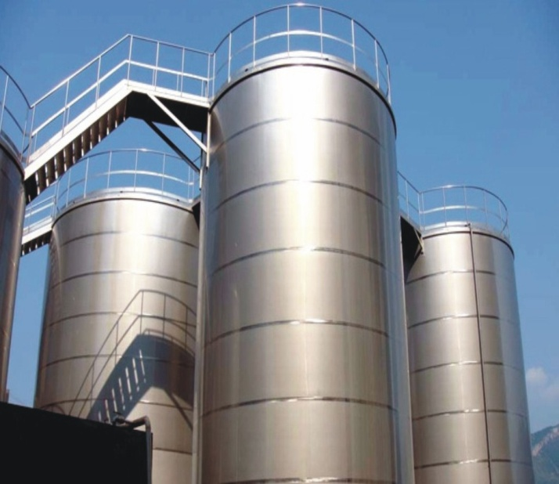
In this presentation we will demonstrate how and more importantly why we calibrate large bulk oil cylindrical vertical storage tanks using the latest on-field optical techniques and modern computerized analysis.

Slide 6
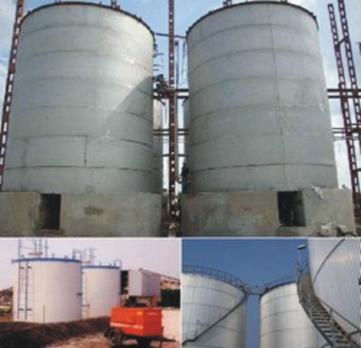
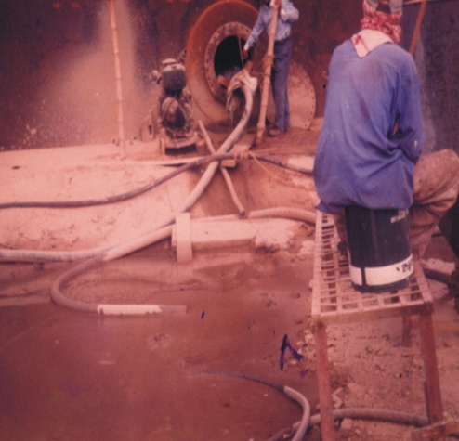
The Problem – Inaccurate Volume
Large tanks have varying diameters from top shell to bottom shell not perceived by naked eye.
Many due to tank settling, hydrostatic product head pressure, temperature in daily operation.
Also due to unavoidable imperfect construction, repairs.
Tank shells expand / deform gradually in time.
If not taken into account, leads to accumulated huge product losses or impractical gain.
It will also strain your credibility with client / vendor and dispute with excise / customs.

Slide 7
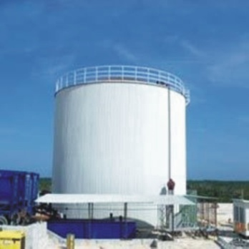
Problems on scaffolding
Digital optical method solutions
Scaffolding around tank
Scaffolding not practical at all locations.
Lots of manpower required at site, availability and
skill is a big problem.
Vital safety questions on scaffolding.
Time consuming.
Strapping tapes require parallel path without sagging
around the tank circumference – difficult to maintain
on high scaffolding & windy conditions.
Difficult to maintain even strapping tape tension of
4.5 kgf on high scaffolding may result in inaccurate
circumference readout and hence inaccurate volume.
Analog tape reading dependent on the personnel on
scaffolding , in-consistent parallax & human error can
occur.
Tape path around circumference is localized, tilt
bulges and expansions are not measured.
No scaffolding required.
No location problem.
Single or 2 operators required.
Completely safe – from ground.
Fast execution.
Digital total station system is leveled electronically
instantly without physical intervention from the
ground itself.
Very accurate, fast and error-free digital reading
which is analyzed on computer software to provide
accurate volumes at all levels.
No analog approximation – direct digital readings
from station to computer no parallax - viewfinder .
reticule aligns directly with tank edge.
Angular readings are spread out evenly around the
circumferential plane which gives us total indication
of tank bulges, contractions, tilt and shape.

Slide 8
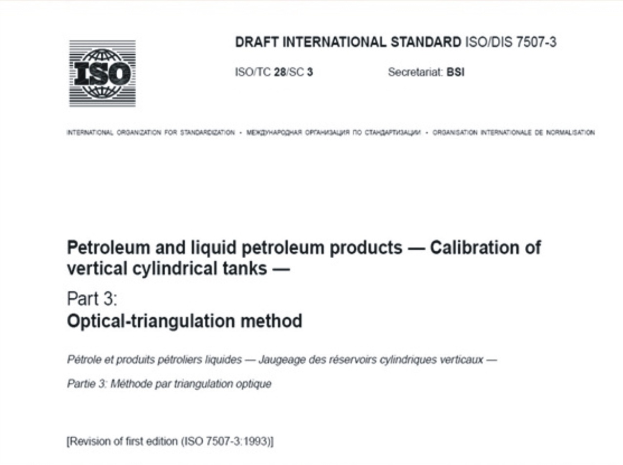
In combination with circumferential strapping of a reference shell as per API 2550 or ISO 7507 (1), we follow “Optical Triangulation method” for calibration of vertical cylindrical tanks as per ISO 7507 – part 3 International standard. Here we will see how we use a Digital electronic total station combined with computer software to get diameters for all the shells up to the top. This method is better than EODR, which we will explain later.

Slide 9
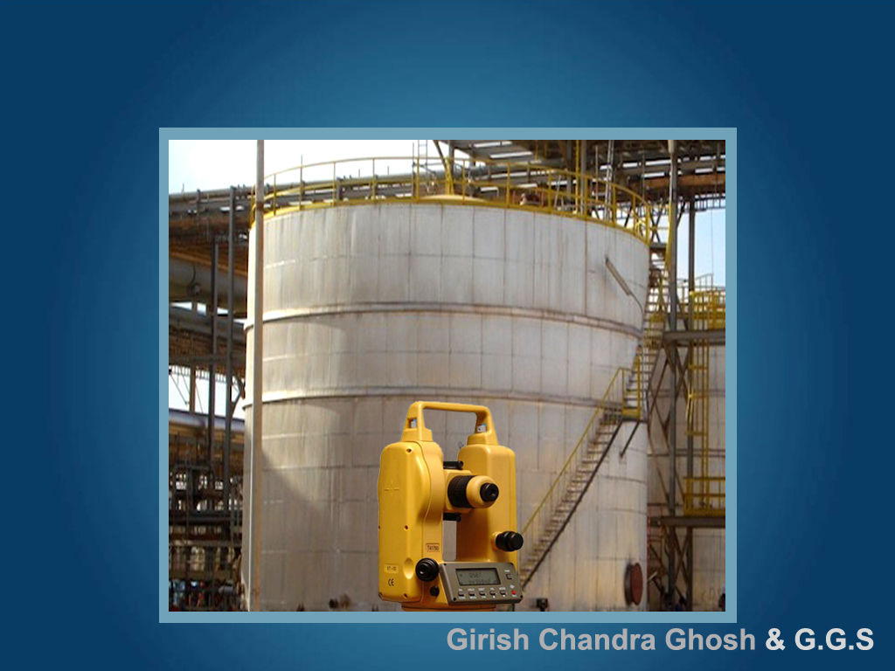
The station is placed on a tripod on a fixed position and leveled. We need to measure the angular value between points A and B on a particular shell. A and B is a horizontal plane and are end points on the shell which are tangential to our line of straight
A
B

Slide 10
The station telescope is pointed to wards point A
A
B

Slide 11
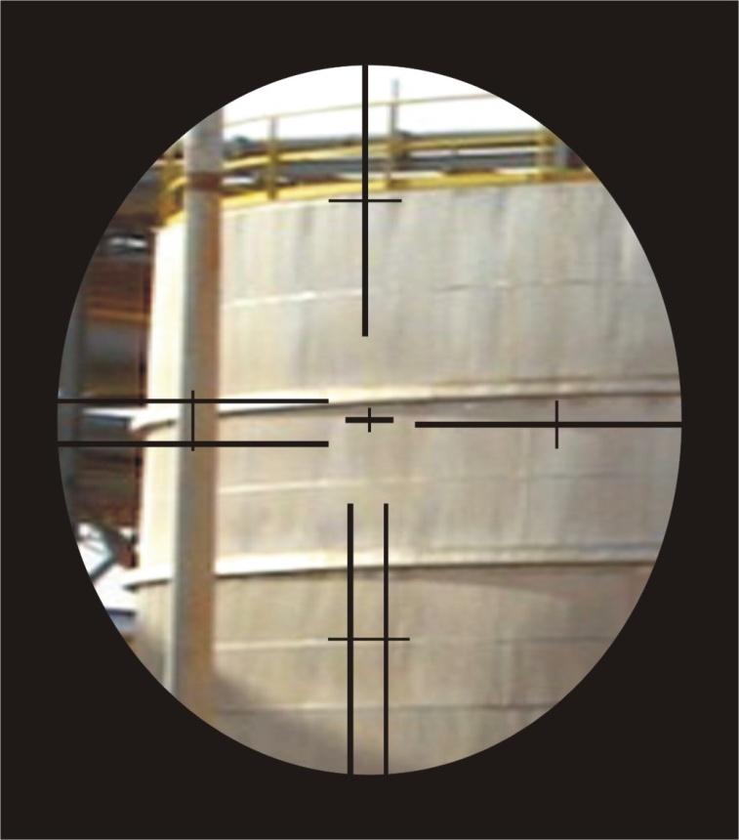
A
This is what we see through the viewfinder. The edge of the tank shell is sighted tangentially coincide with the central cross mark of the viewfinder.
This point is ‘A’. In this case note that at the top of the viewfinder the tank wall starts to deform (expand) a little to the left

Slide 12
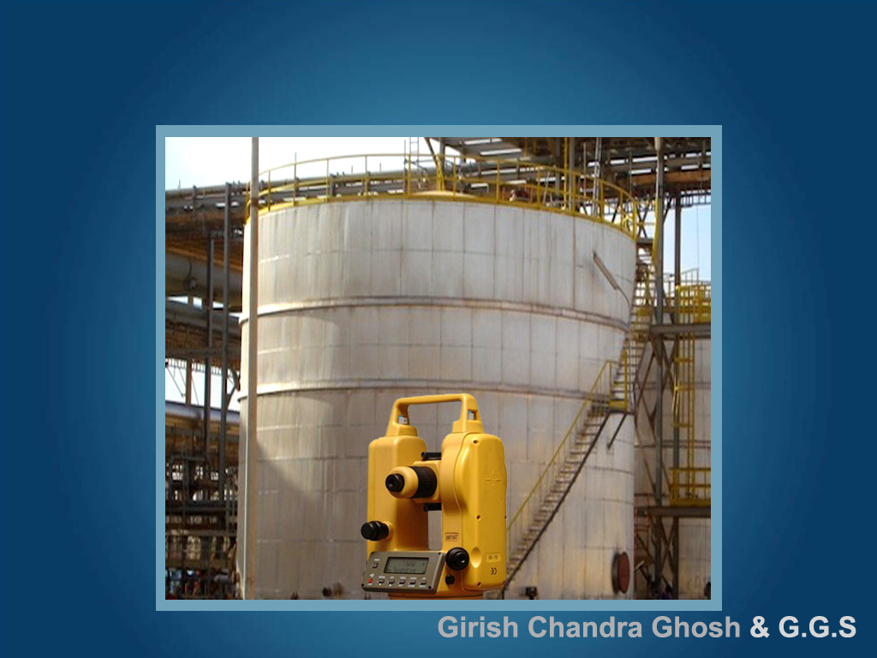
The station is now rotated right to point B horizontally and a similar sighting made. The angular value between point A and B is noted in highest resolution in degrees, minutes and seconds.
A
B

Slide 13
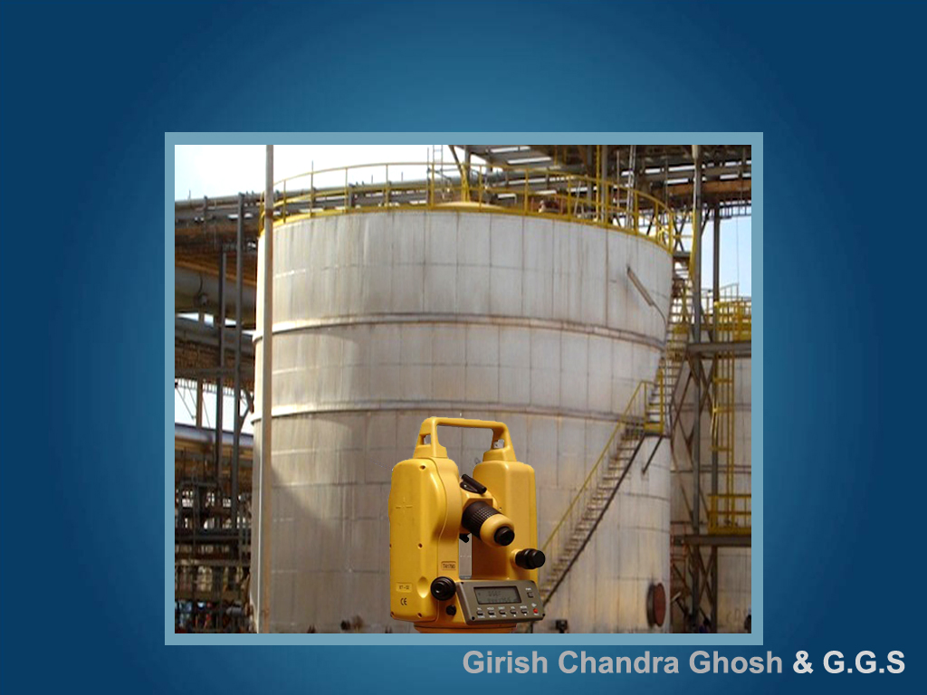
Without moving the equipments positions, similar sighting is made at a higher positioned shell between C and D and it’s angular value noted.
Likewise angular values are measured for all shells from top to bottom.
C
D

Slide 14

Without moving the equipments positions, similar sighting is made at a higher positioned shell between C and D and it’s angular value noted.
Likewise angular values are measured for all shells from top to bottom.
C
D

Slide 15
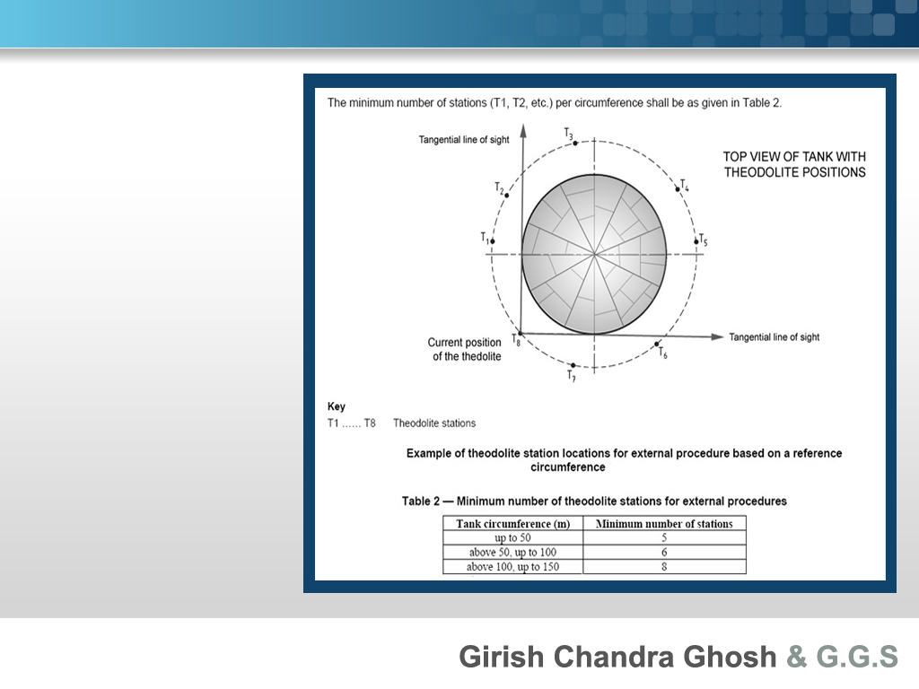

All the above steps are repeated for at least 5 to 12 positions all round the tank circumference depending on the size of circumference.

Slide 16
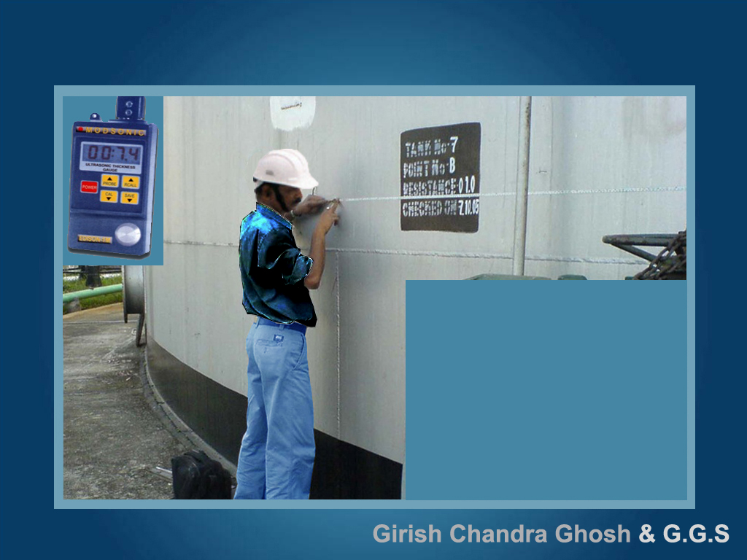
We now need to measure only one reference external circumference (Preferably on 1st or 2nd shell) accurately 3 times at an accessible height by strapping steel tape.
Other important measurements which are carried out as per rule
Datum level determination
Dip points and hatch height
Dip reference height
Deadwood determination
Bottom dead stock volume
Floating roof weight
Shell thickness and strake height
Measurement temperature

Slide 17
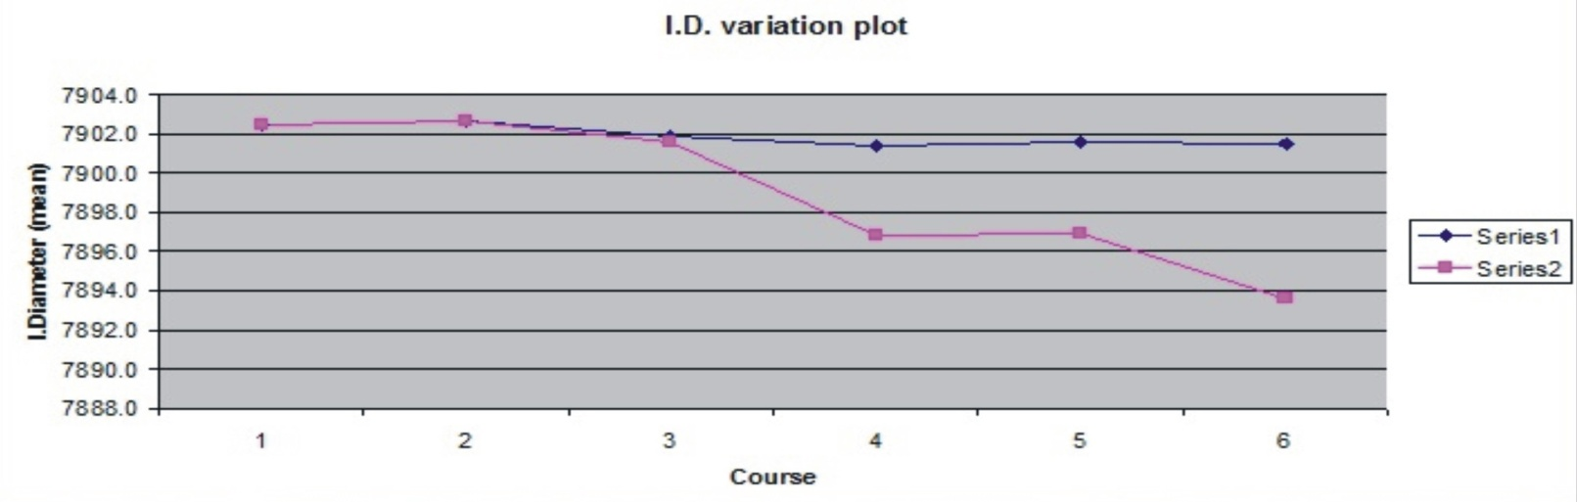

This is an example showing i.d and lit/cm variations when calibration is done on a large 60000 KL tank. You can see that strapping of shells on scaffolding on upper course has caused large variations leading to a volume loss of the tank owner of approx. 40 KL. The blue line on the graph is data obtained by us by the methods we have demonstrated.
Tank No. - HT 07 (60000 KL F.R. Tank)
Lit/cm comparison
i.d. comparison
Course no. | Course height | Open capacity in our chart lit/cm | Open capacity in our chart lit/cm | Difference lit/cm | Net volume difference
1 2 3 4 5 6 | 235.9 250.0 250.0 250.0 200.0 138.5 | 49047.85612 49049.78299 49040.38767 49034.67863 49036.27913 49034.81402 | 49048 49050 49036 48977 48978 48937 | -0.1 -0.2 4.4 57.7 58.3 97.8 | -34 -54 1097 14420 11656 13547
 |  |  |  |  | 40632
Course no. | i.D as per new calibration cm | i.D as per old calibration cm | i.D diff cm
1 2 3 4 5 6 | 7902.5 7902.7 7901.9 7901.4 7901.6 7901.5 | 7902.5 7902.7 7901.6 7896.8 7896.9 7893.6 | 0.0 0.0 0.3 4.6 4.7 7.9
Previous data
Current data

Slide 18
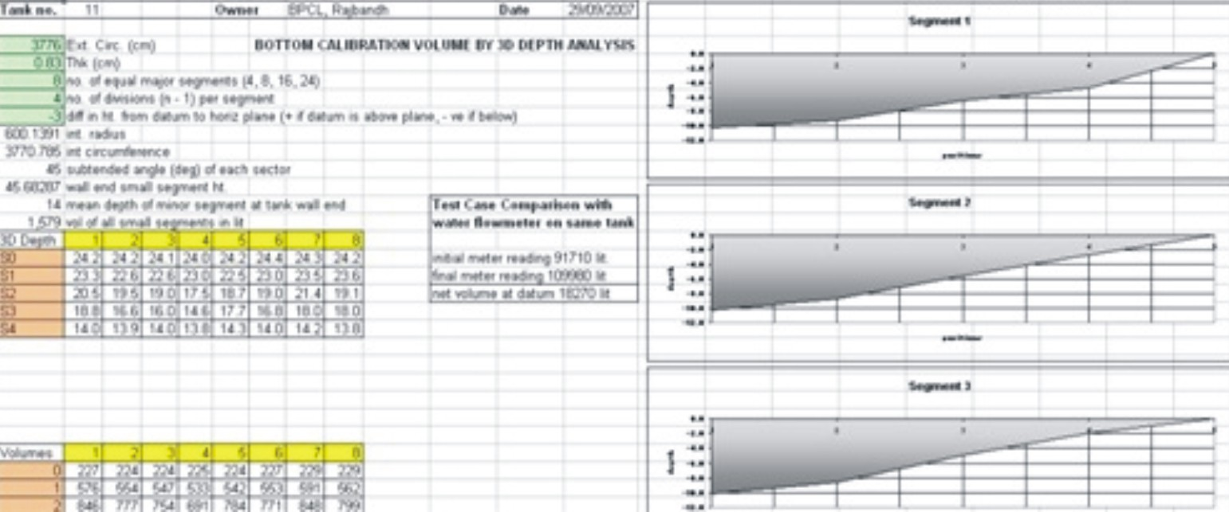

Tank Bottom Calibration
Large tanks have floors that are uneven and may be of cone up or down shape. If you are empty, dead stock volume may be needed to be determined upto datum level.
Apart from the traditional bottom calibration with water and flowmeter / prover, we undertake 3D dry survey of tank bottom with advanced laser leveling and depth measurements.
When the floor data is analyzed on our customized softwares, we get a 3D contour from where we can accurately determine tank bottom volume upto datum plate and beyond to flush level.
Its fact, accurate and does not require water or proving liquid.

Slide 19
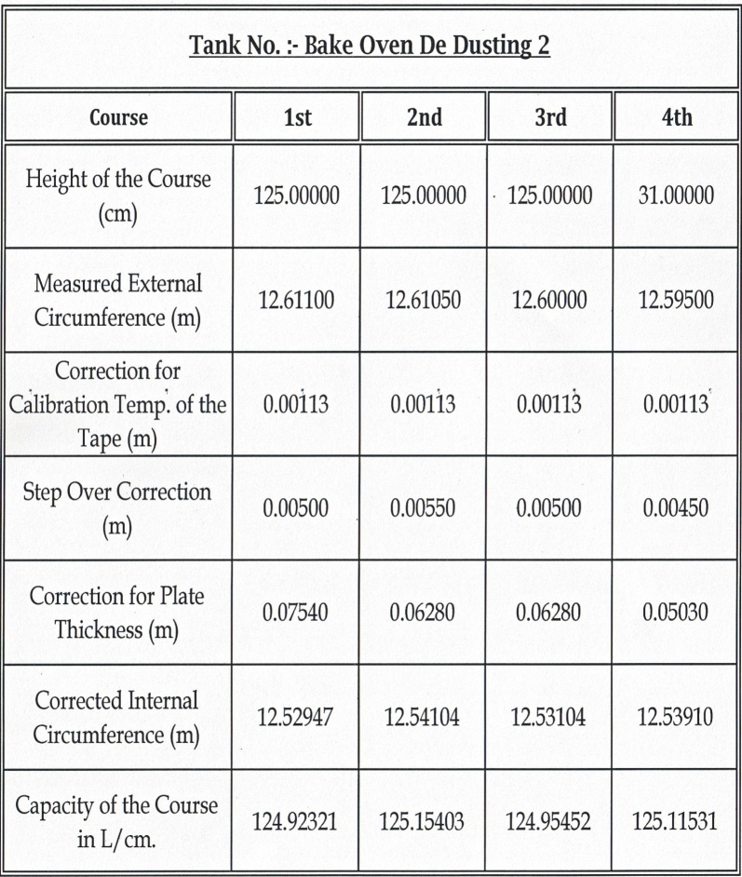
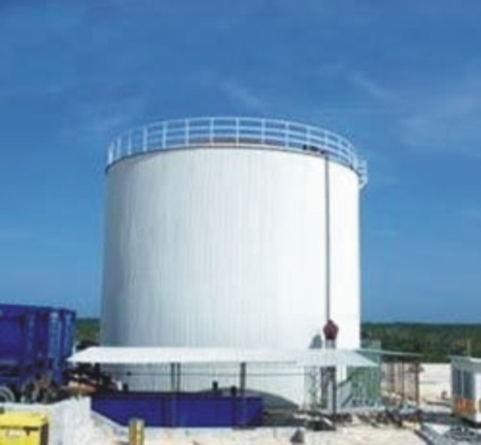

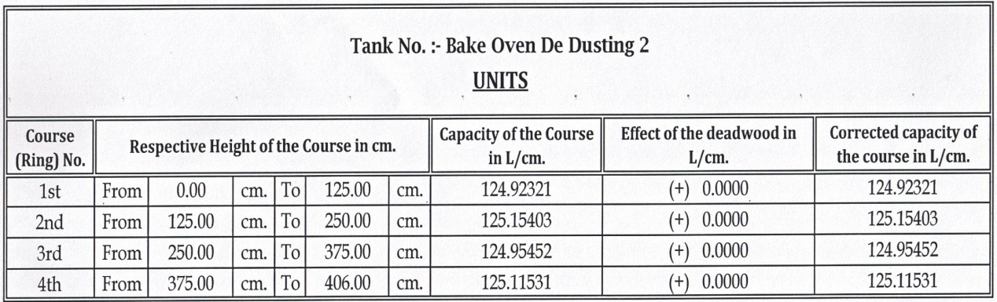
Computerized processing of field data
All field data are logged on our computers. First, application of temperature, thickness & step-over corrections on this reference circumference is made to get an accurate “reference internal radius” at this level of the tank shell.

Slide 20
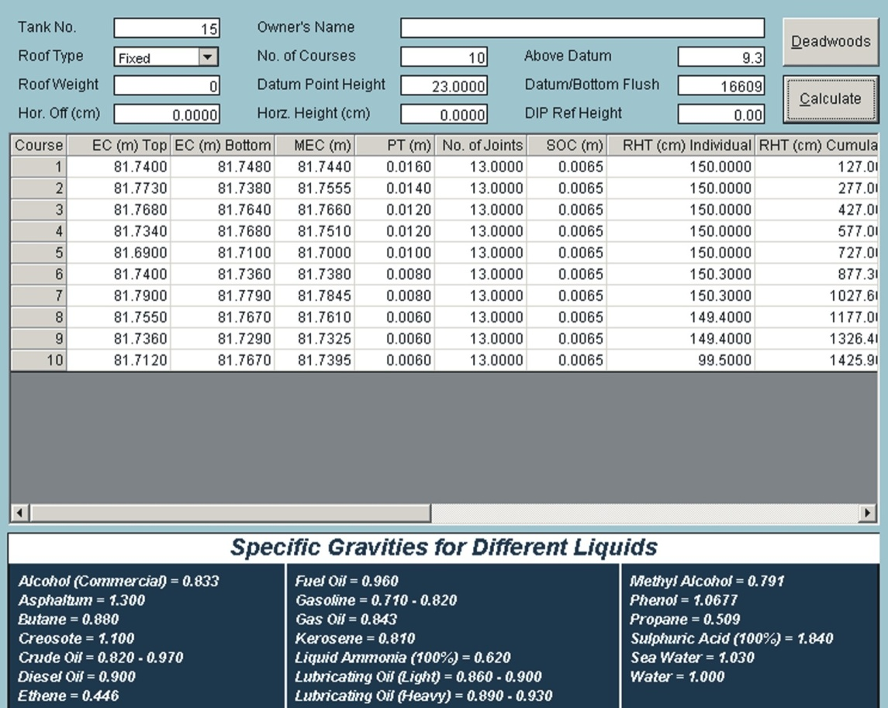

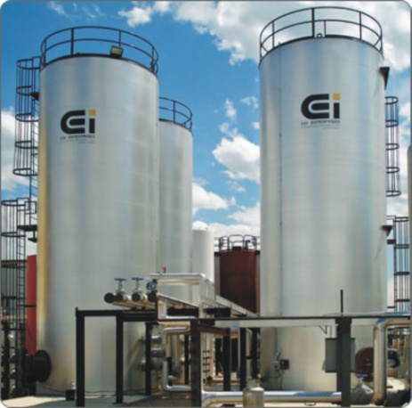
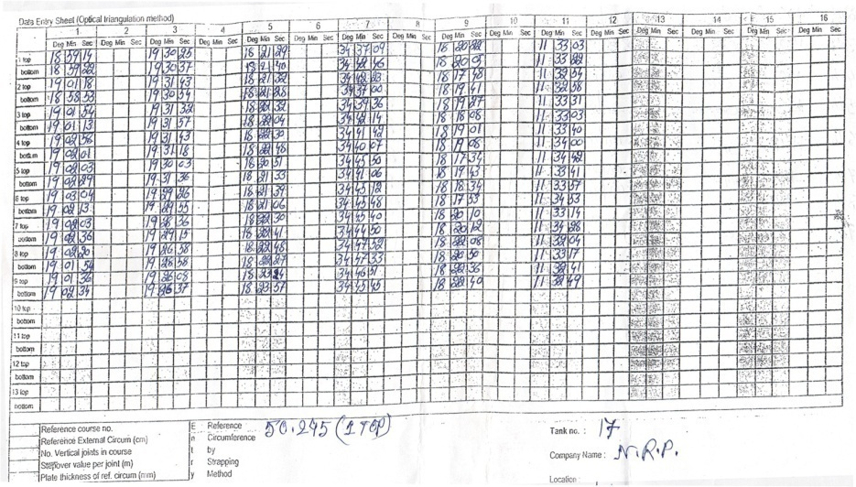
Computerized processing of field data
This reference radius in combination with the total station readings is used to compute radius / diameter at all levels from top to bottom of the tank by complex triangulation and calculation on our advanced customized software.

Slide 21
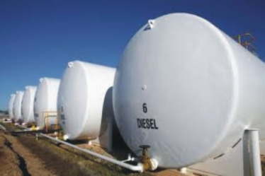
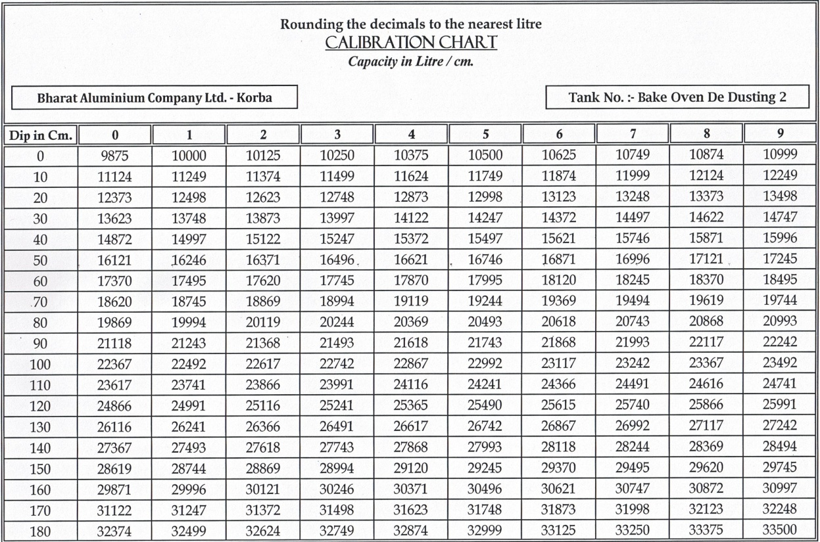
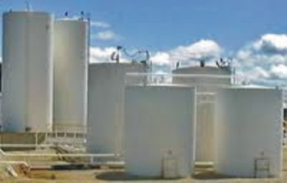
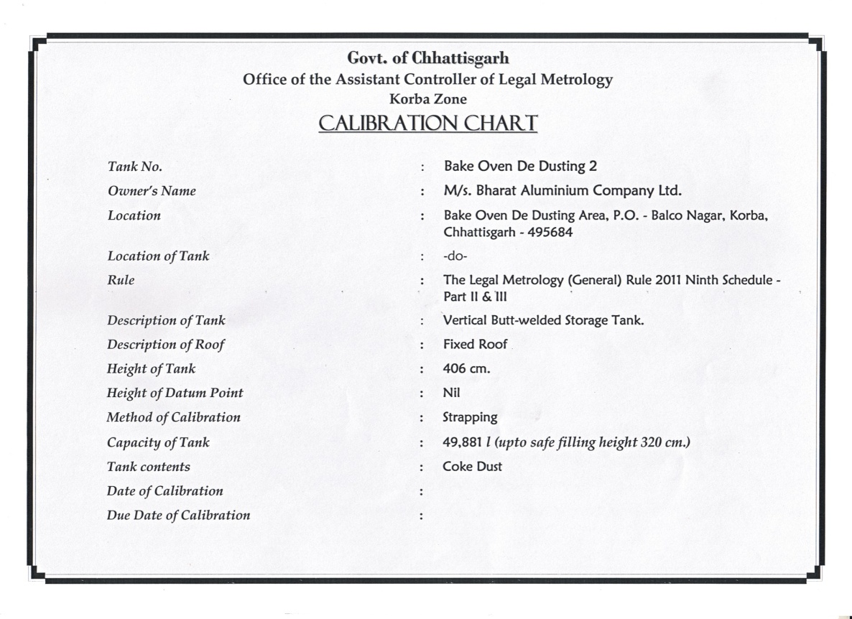
Finally the Calibration Chart
Tank volume at all heights are calculated accurately and error-free with calibration charts made as per client specifications and standard metrology rules. Data is also given on CD/email.

Slide 22
Advantage of Optical Triangulation over EODR
Electro optical distance ranging (EODR) process involves not one but numerous total stations the circumference where distance measured between them and the tank shell tend to be inconsistent more due to the fact the laser distance meters on the total stations have an inaccuracy range of +ve, -ve 3 to 5 mm, which is not acceptable at such a close distance to the tank when used for calculations. It has more disadvantages than advantages as a simple position error around tanks. Also in EODR we have to depend solely on the total station equipments, as there is no reference tank strapping method around the circumference to setup a basis for further measurements. We had tested out this method earlier and have found that optical triangulation is more accurate and flexible. Optical triangulation is done with vey high resolution of accuracy +ve , -ve 1 second. 1 second = 1/3600 degree. It can be placed anywhere around the circumference, even on an adjacent building and does not require any distance readings. Numerous tangential angular reading around the circumference gives very accurate tank radius based on a reference radius measured by strapping.

Slide 23
Our Clients believe in us
Indian Oil Corp. Ltd.
Hindustan Petroleum
Bharat Petroleum Corp. Ltd.
I.B.P.Co. Ltd.
Castrol India Ltd.
Tata Iron & Steel Co. Ltd.
Hindustan Unilever Ltd.
Damodar Valley Corp.
Shalimar Chemical work Ltd.
Reliance Engg. Associates Pvt. Ltd.
United Brewireis Ltd.
CESC Ltd
Dabur India ltd.
Tata Power Co. Ltd.
Britania Industries Ltd.
Haldia Petrochemicals Ltd.
IFB Agro industries
Orissa Sponge Iron Ltd.
PNP Eng. Works Pvt. Ltd.
Exide industries
Dhara Vegetable Oil Food
Haldia dock Complex
I.M.C Ltd.
Punj Lloyd Ltd.
Reliance Industries Ltd.
Nicco cop. Ltd.
Follow next slide …

Slide 24
Our Clients believe in us
Mother Dairy (Calcutta) Dankuni
Khaitan (India) Ltd. Nadia
M.P.Giychem lndustriesLtd.(RANCHI)
Essar Oil Ltd.
United Storage & Tank Terminal Ltd.
Dhara Vegetable Oil Food Co. Ltd.
Ajanta Bottles & Blenders Pvt. Ltd.
Tata Chemicals Co. Ltd.
Vedant Aluminum Ltd.
Emmai Limited.
Mistubishi Co. Ltd.
Balmer Lawaries & Co. Ltd.
Vijay Tank & Vessels Ltd. Gujrat
IFB Agro industries
Indus Project Ltd. Haldia
Radiant Manufacturers Pvt. Ltd.
Hi-Tech Carbon. Haldia
S.K. Oil & Co. Ltd.
Cheviot CO. Ltd. Budge Budge
Indian Oil Corp Ltd. N.J.P
Bokaro Steel Plant Steel City. Jharkhand
Jindal Steel & Power Ltd. Chattishgarh
M. K. Roy & Bros. Project Ltd.
And many others…
*See our website for more client list

Slide 25


M/S GIRISH CHANDRA GHOSH & G.G.S.
Excellence you look for…

Slide 26
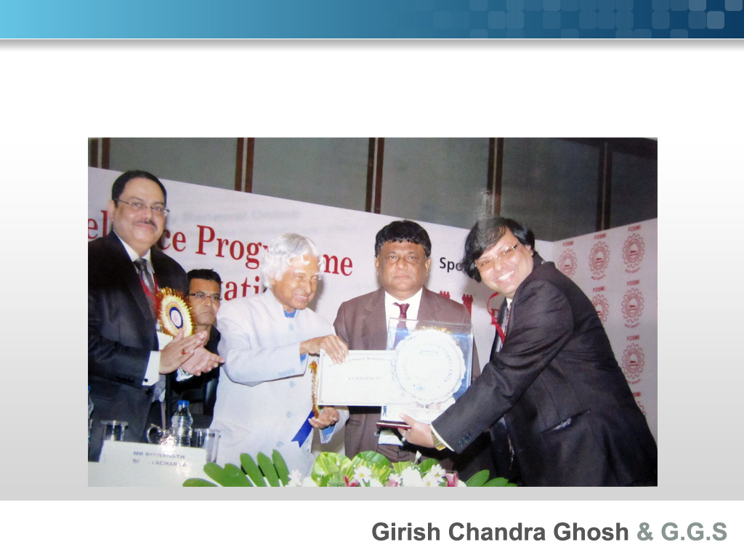
12th FOSMI Awards for Excellence Programme and Seminar on Technology & Innovation: The Future for MSMEs.
20th August, 2013. ITC Sonar, Kolkata
Receiving Award of excellence in Service Sector - 2013

Slide 27
Customer satisfaction is our first motto….
Call us today
M/S GIRISH CHANDRA GHOSH & G.G.S.
Contact Details :
Head office – 40/2, B . T. Road (Kantakal), Kolkata – 700 002, WB.
Works – 37B, B .T . Road (Kantakal), Kolkata – 700 002, WB.
Cell – 0-9830081365 (Supriyo Ghosh)
Telephone – 033-2558-9089
TeleFax - 033-2558-9089
E-mail – gcg.ggs.kol@gmail.com / gcg_ggs@rediffmail.com
Website – www.girishcalibration.com
We are successfully spread in manufacturing & service sectors.

Slide 28

We all need you for Leadership, Style Delegating, supporting, Coaching & Directing.
H.O – 40/2, B . T. Road (Kantakal),
Kol – 2, WB.
Works – 37B, B . T. Road (Kantakal),
Kol – 2, WB.
Cell – 0-9830081365 (Supriyo Ghosh)
Telephone – 033-2558-9089
TeleFax – 033-2558-9089
E-mail – gcg.ggs.kol@gmail.com/
gcg_ggs@rediffmail.com
Website – www.girishcalibration.com

